Slide 1

IRONHACK DATA ANALYTICS MID BOOTCAMP PROJECT
CHIDUBEM EZENWAFOR

Slide 2

WOOD PRODUCTS
Introduction
Data was obtained from https://unece.org/forests/data-forest-products-production-and-trade#accordion_0
Contains trade and harvest data from 1964-2021
Primary goals
-observe raw material export
#observe competitions between selected raw materials and woodfuel
-analyse Balance of trade
- analyse value for unit products exported
- analyse harvest to export ratio to determine how much local industry consumption and with more data explore wastage
-observe engineering board production

Slide 3
CHALLENGES
-Lots of missing Data with 0 values and empty cells
-Lots of Data belonged to defunct states
SOLUTION
-Spent most time cleaning data
-dropped all defunct states and their breakout states
-replaced empty cells with 0, and dropped Nan majority in cases where it is the majority, with no value in the time frame we were interested in(2007-2021)

Slide 5
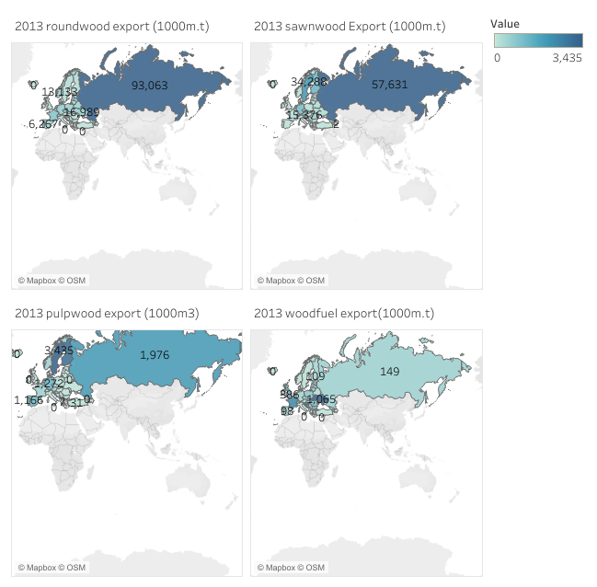
BIGGEST EXPORTERS OF SELECTED RAW MATERIALS AND WOODFUEL
SELECTED RAW MATERIALS
Roundwood
Sawnwood
Pulpwood

Slide 6
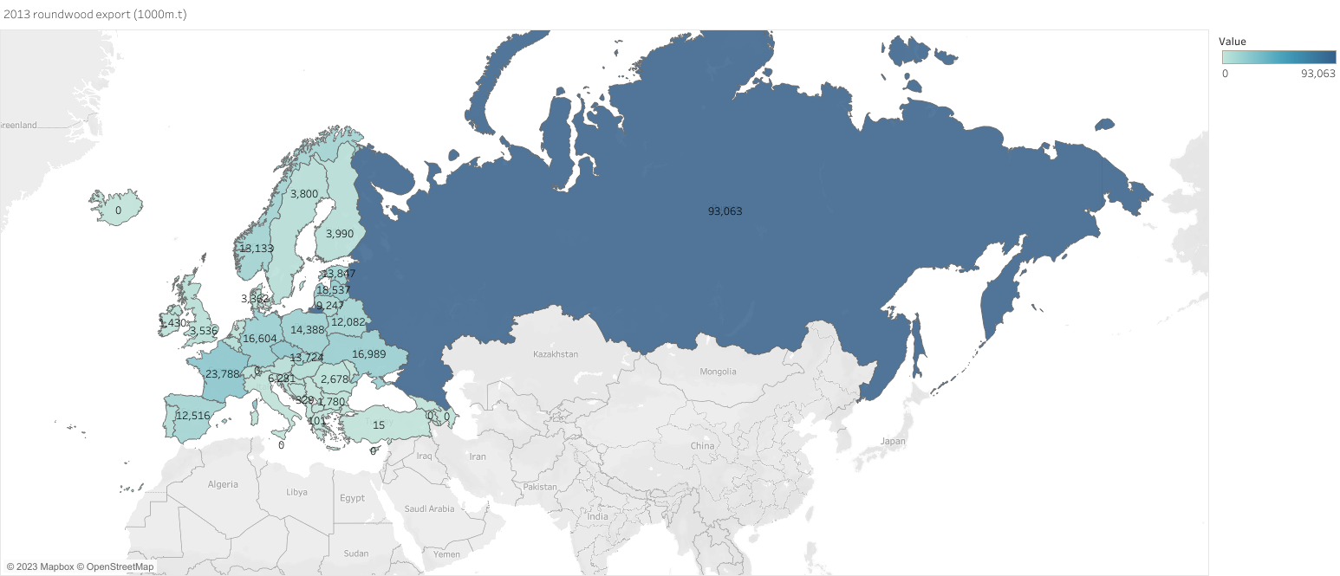
ROUNDWOOD EXPORT 2013

Slide 7
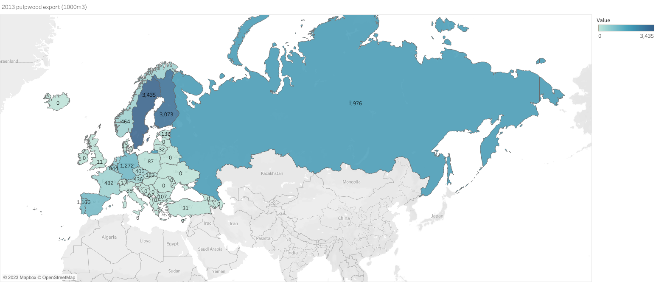
Pulpwood Export 2013

Slide 8
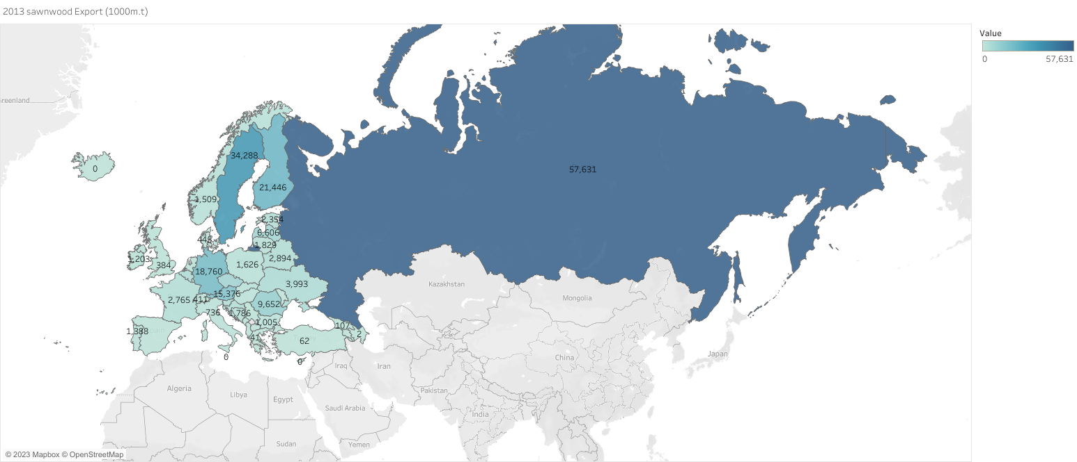
SAWNWOOD EXPORT 2013

Slide 9
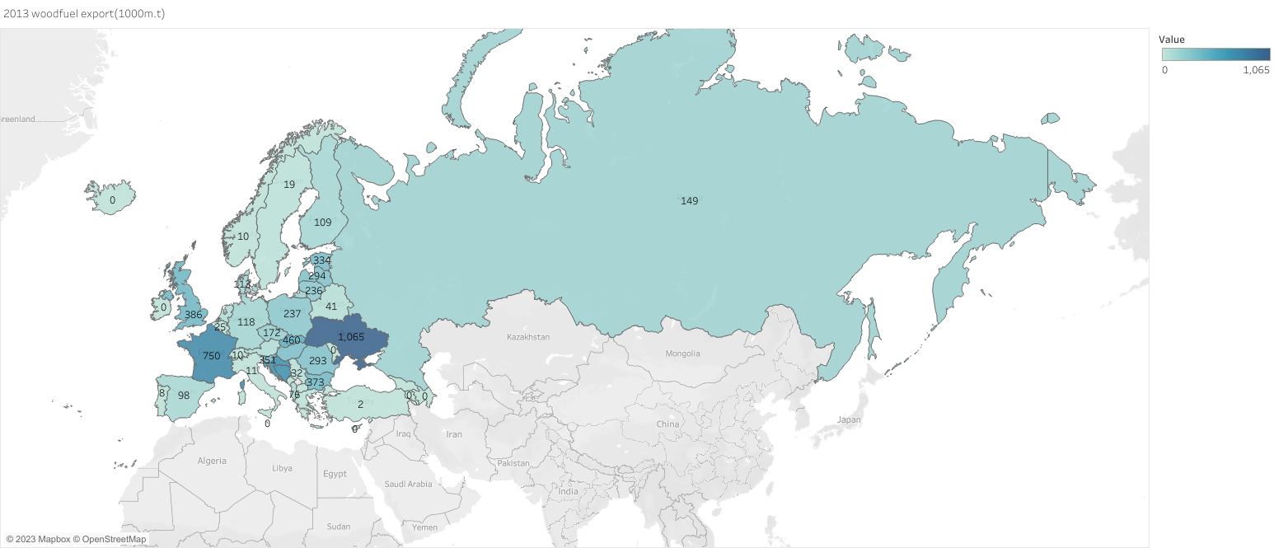
WOODFUEL EXPORT 2013

Slide 10
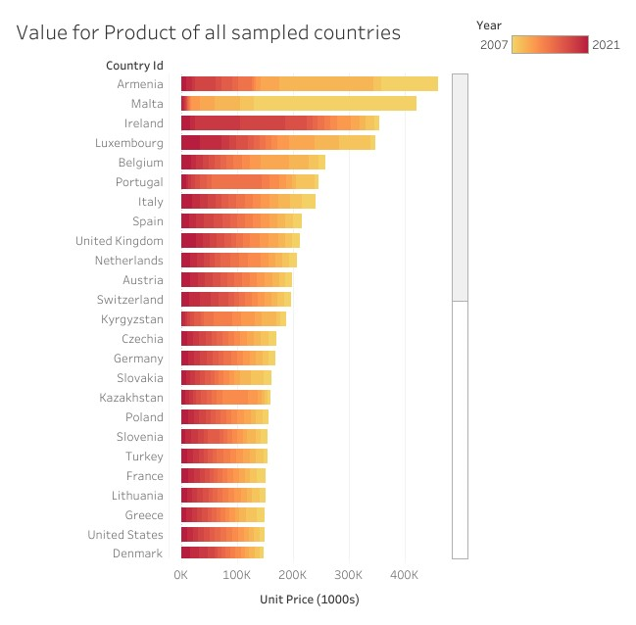
COMPARING VOLUME AND VALUE OF PRODUCTS

Slide 11
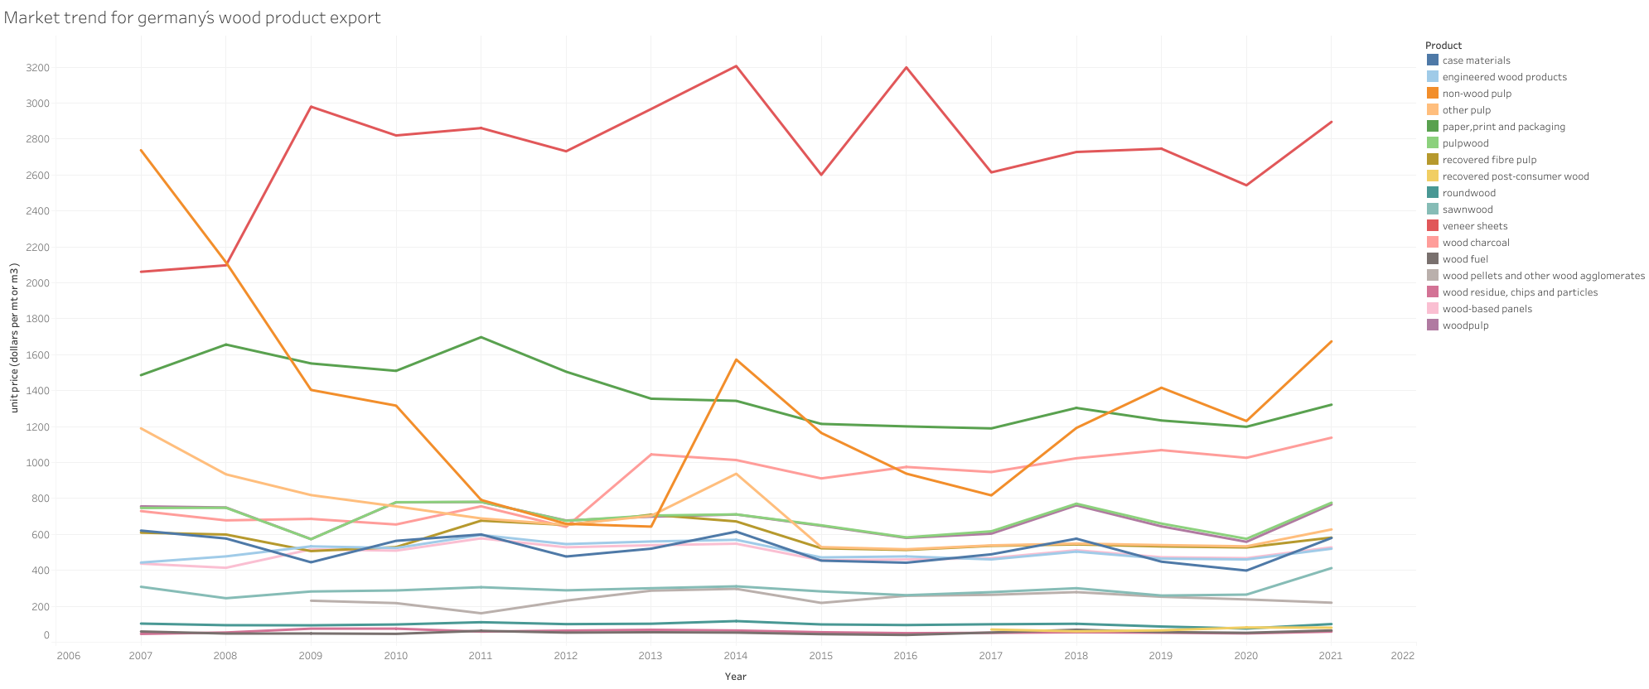
Price Trend of German exports from 2007-2021

Slide 12
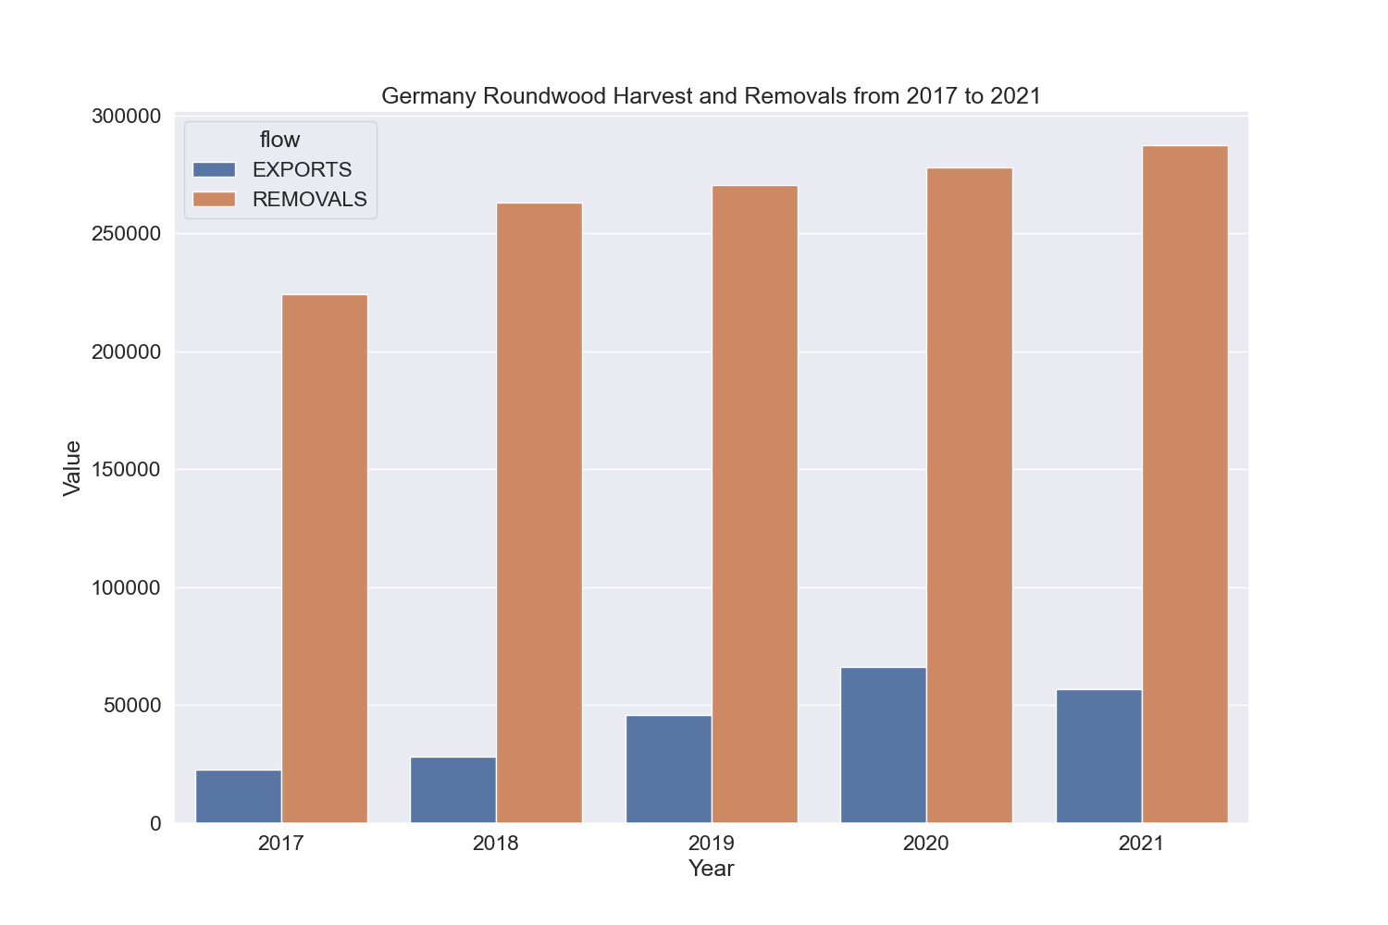
Harvest to Export Ratio *Useful to explain raw material use by local industry

Slide 13

Engineering board Production in Europe

Slide 14
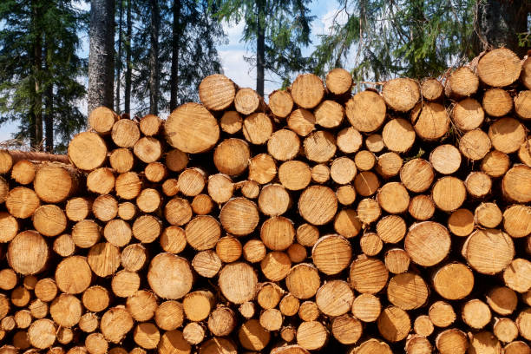
THANKS FOR YOUR ATTENTION
THE END

